Slide 1
The Voter’s Choice Act
Choose how, when, and where you vote
A presentation for community members

Slide 2
Which counties are adopting the VCA?
Amador
Butte
Calaveras
El Dorado
Fresno
Los Angeles*
Madera
Mariposa
Napa
Nevada
Orange
Sacramento
San Mateo
Santa Clara
Tuolumne
Notes:
In 2020, 15 counties in California (which accounts for half of CA’s registered voters) are implementing a new election model under the Voter’s Choice Act and all CA counties now have the option to adopt. Los Angeles will not automatically send all registered voters a vote by mail ballot until 2024. The counties in bold piloted the VCA in 2018 and the rest will be adopting for the first time in 2020.

Slide 3
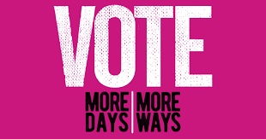
How is voting changing in my county?
In 2016, California passed the Voter’s Choice Act (VCA) to give voters more options for how they vote.
All registered voters will automatically receive a vote by mail ballot in the mail
You have three ways to vote
Notes:
In 2016, California passed the Voter’s Choice Act. This law aimed to make voting more convenient in select California counties. In a county that has adopted the Voter’s Choice Act election model, you choose how, when, and where you vote. All registered voters in the county will automatically receive a vote by mail ballot in the mail (regardless of whether they requested one) and have three ways to vote.

Slide 4
Three Ways to Vote Under the VCA

Slide 5
1. Vote By Mail
All registered voters automatically receive a vote by mail ballot
Return your ballot by mail
Notes:
Now, all registered voters in a VCA county will automatically receive a vote by mail ballot approximately 29 days before Election Day. You no longer need to request one or sign up as a vote by mail voter. You can return your vote by mail ballot in the mail (no postage needed). Your vote by mail ballot must be postmarked by Election Day.

Slide 6
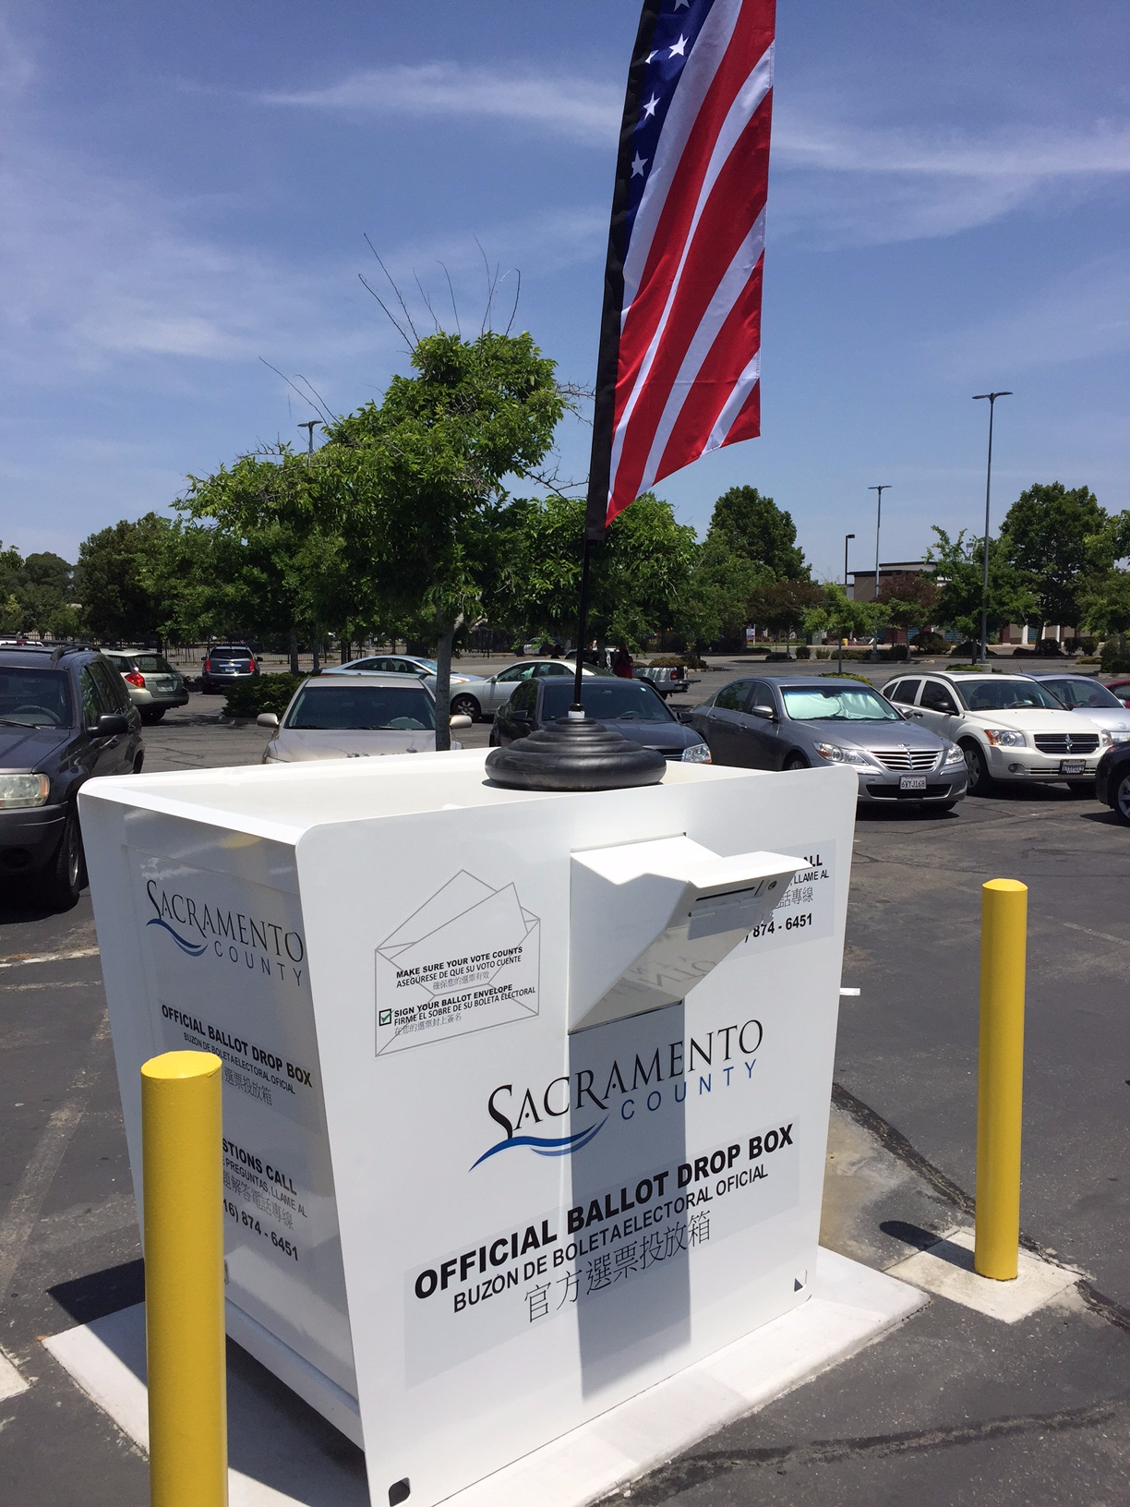
2. Return Via Drop Box
Place ballot in secure drop box
No postage needed
Located throughout the county
Notes:
You can also drop your vote by mail ballot in one of the designated drop boxes located throughout the county (no postage required).

Slide 7
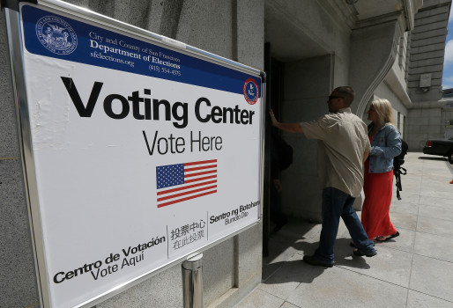
3. Vote at a Vote Center
Vote in person or drop off your ballot at any vote center
Limited number but offer more services
Notes:
Traditional polling places will be replaced by vote centers, which are like jumbo polling places that offer a variety of cool services. Although a limited number of vote centers are available, you can visit any vote center in the county and they are open for more days. Now, let’s talk about all of the features of a vote center…

Slide 8
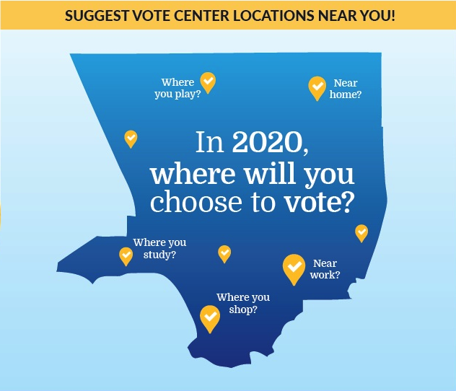
Vote Center Features
Early voting and location flexibility
Notes:
Vote centers offer some advantages over traditional polling places:
Early voting – Some vote centers are open 10 days before Election Day and all vote centers are open 3 days before Election Day. This includes weekends!
Location flexibility – Vote at any vote center in your county, not just the one closest to home. Vote near work, the gym, the grocery store, your children’s school, your place of worship, etc. To find the vote center nearest you, check your county voter information guide or go to your county election office’s website.

Slide 9
Services at Vote Centers
Same-day voter registration (CVR)
Translated voting materials
At least 3 accessible voting machines
Notes:
Vote centers also offer a number of services.
You can register to vote and then vote the same day at any vote center, even if you missed the voter registration deadline (which is 15 days before election day).
You will find at least three accessible voting machines for voters with disabilities.
You will find a variety of translated voting materials and may even receive in-person language assistance. Just ask!

Slide 10
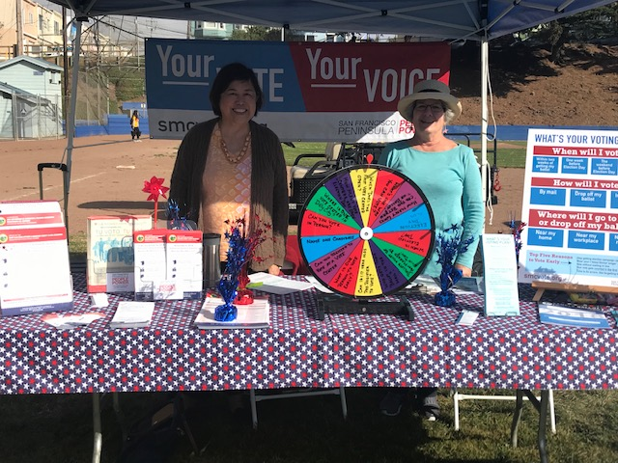
Why The VCA?
To make voting more convenient for all
We need YOUR help to ensure these changes lead to greater participation rather than confusion
Notes:
The goal of the VCA is to make voting more convenient for all by providing voters with more ways and days to vote. Over time, the VCA also aims to lower costs for election offices. We want to make sure voters are aware of these changes so they are not caught off guard when their neighborhood polling place disappears or they receive a VBM ballot they did not request in the mail. That’s why we need YOUR help to spread the word about the VCA.

Slide 11
How to Get Involved

Slide 12
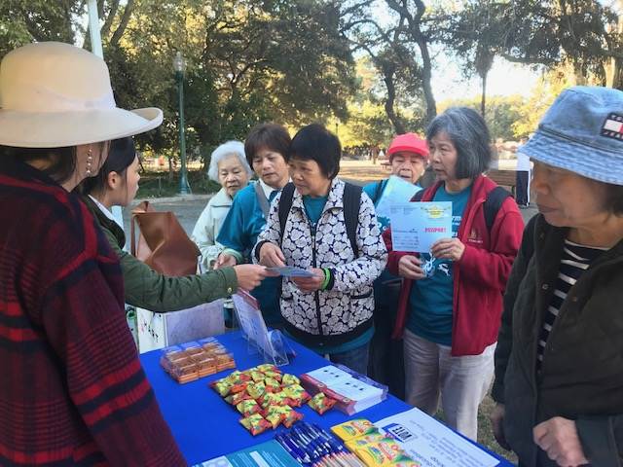
Host Events and Spread the Word
Raise awareness about the different ways to vote in your community!
Host a workshop
Make public announcements
Share information on social media
Table at community events
Notes:
In order to ensure all our communities can fully access the vote, help spread the word about the many options to vote in your county. For instance, you might host a voter education event, share information on social media, and table at markets and other community events. You can also make announcements in the classroom, at work, at your place of worship, and elsewhere.

Slide 13
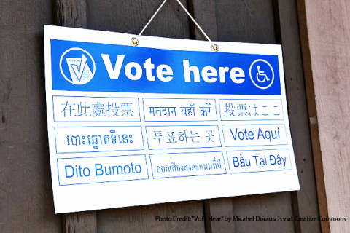
Join the LAAC or VAAC
Open to everyone
No experience needed!
Language Access
Advisory Committee (LAAC)
Voting Accessibility Advisory Committee (VAAC)
Notes:
Your county elections office has formed advisory bodies made up of everyday community members and advocates. The Language Access Advisory Committee (LAAC) advises the elections office on outreach to and accessibility for limited English speaking voters. The Voting Accessibility Advisory Committee (VAAC) advises the elections office on outreach to and accessibility for voters with disabilities. Your county may also have a Voter Education and Outreach Advisory Committee (VEOAC) that provides guidance on voter education and outreach strategies generally. Reach out to your county elections office to find out more!

Slide 14
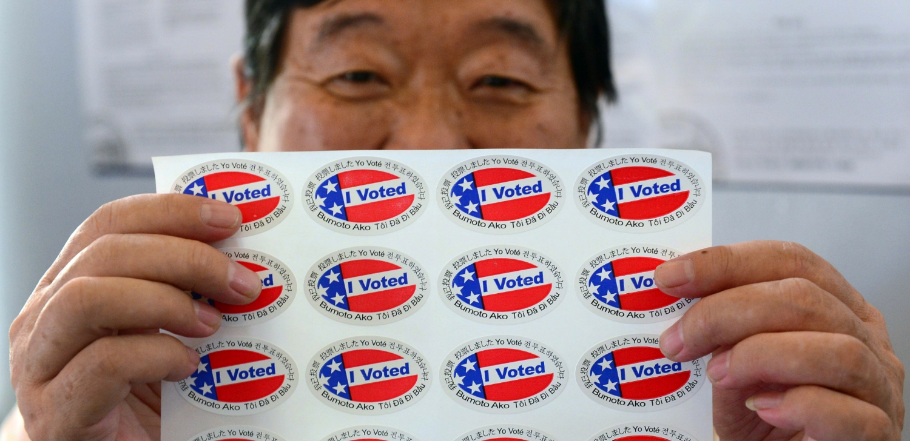
Questions?
Contact
Nicole Wong
Voting Rights Community Advocate
Advancing Justice - Asian Law Caucus
nicolew@advancingjustice-alc.org; 415-848-7715

