Slide 1
Voter Registration Training

Slide 2
Who Can Vote?
You can vote in this election if you are:
U.S. Citizen
Resident of California
18 years old or older on Election Day
Not currently in prison or on parole for a felony
Not found by a court to be “mentally incompetent”
** Note: you can pre-register to vote if you are 16 or 17

Slide 3
Key Dates for November 2020 Election
We recommend that you register to vote by Monday, October 19, 2020
If you have not registered by Oct. 19, it is not too late!
Voters can register & vote on the same day at their county elections office from Oct. 19 - Nov. 3.
Voters can also register & vote on the same day at any voting place.
Your ballot will be counted once your registration is verified.
Notes:
Oct. 19 is the official deadline, register by then to have your ballot mailed to you before election day.

Slide 4
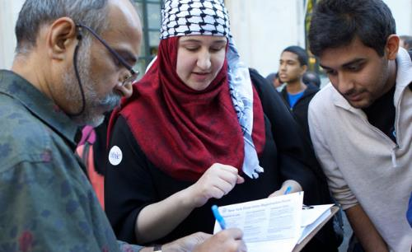
When to Re-Register
1. Move to a new permanent address.
2. Change name.
3. Change political party choice.

Slide 5
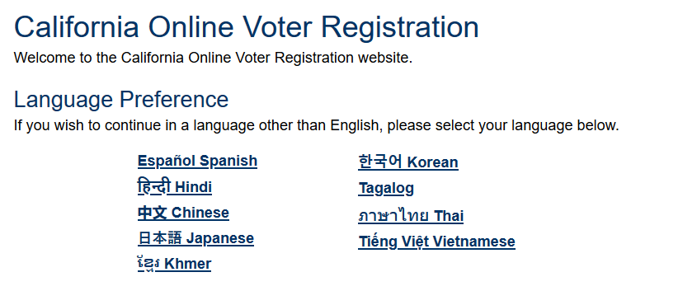
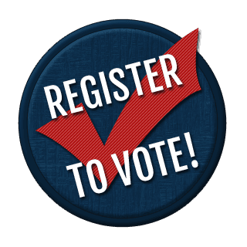
How to Register: Online
You can register online at RegisterToVote.ca.gov
Notes:
The registration questions on the online form are the same as the ones on the paper form, but are arranged in a slightly different order. The order of the content in this presentation corresponds with the order of the online form.

Slide 6
How to Register: Paper Form & In-Person
You can get a paper voter registration form at your county elections office, library, DMV office, or U.S. Post office
You can ask for a paper voter registration form to be mailed to you for free by calling (800) 345-VOTE(8683)
Be sure to postmark your registration form or drop it off at the county elections office by Oct. 19

Slide 7
Preliminary Questions: Are you a U.S. citizen? Do you meet age requirements?
Ask each person when reviewing their voter registration form if they are a US citizen.
If they are, make sure the box is checked
If they are not, tear up their voter registration form
*Note: non-citizens who make a false claim can face potentially serious immigration consequences

Slide 8
Name & Contact Information
The form asks for name and birthday.
It also asks for email & phone number, which are optional.
It is helpful to provide email & phone.
If there is a mistake with your form or ballot, the county elections office must reach out to the voter to allow them to fix it. Email/phone are the most convenient ways for them to contact you.
Notes:
- Note, however, that once you provide your phone and email address this becomes public information. Campaigns can access your contact information and you may for example receive robocalls from campaigns.

Slide 9
Place of Birth
U.S. State or foreign country of birth
U.S. Born: Print the name of the state or territory.
Foreign born
Print the name of the country. Do not abbreviate the name of the country.
This does not say “city” or “county of birth”!
Notes:
If a person is registering online, they will select from a drop-down menu.

Slide 10
Identification
CA ID or Driver’s License or Last 4 of Social Security No.
Notes:
Your ID information is confidential and will only be used for election purposes. It will not be printed on any public reports.
If you do not have CA ID, CA driver’s license, or SSN, you can still register to vote. If you are registering online and do not have this information, you will need to print your registration, sign it, and mail it into the elections office. The state will assign you a unique identification number and confirm your ID the first time you vote.
If the first time you vote is by mail and you did not provide ID information when registering, you should check with you county elections office to confirm your ID. Many types of documents can be used for ID confirmation, such as: a copy of a recent utility bill, the sample ballot booklet you received from your county elections office, a recent vehicle registration at your current address, or another document sent to you by a government agency that includes your current address. You can also provide your passport, driver license, official state identification card, employee id card, or student identification card showing your name and photograph.

Slide 11
Indicate Language Preference
Does a voter need to speak or read English to register to vote or to vote? -> No!
When registering, voters can indicate their preferred language
If translated materials are available for their language in their area, they will get information in that language
Some counties offer fully translated ballots in the following languages: Cambodian/Khmer, Chinese, Filipino/Tagalog, Korean, Spanish, and Vietnamese. More than 25 languages may have assistance available!
Notes:
The voter registration portal is available in 10 languages (including English).
Some counties also have translated reference materials--more than 25 languages are covered. Call your county elections office to find out what other languages you might be eligible to receive limited coverage in in your area. Advise voters to indicate their language preference on their voter registration if they would like to receive translated election materials.

Slide 12
Address Questions
Home Address: the address where a voter lives
Mailing Address: the address where a voter would like to receive election materials
Notes:
P.O. Box and businesses addresses are valid as mailing but not home addresses
The voter only needs to provide mailing address if it is different than their home address
Don’t forget: Apartment number and county in 5-6

Slide 13
Other Notes on Address
Homeless Folks or People Without Stable Housing
People without stable housing can instead describe the location they live
College Students
College students can register to vote at their school address or non-school address (i.e. parent’s home, etc.)
Notes:
Homeless folks: they must still enter a mailing address where they can receive election materials
College students: If they want to register at their non-school address, tell them to use this as their home address, include a mailing (campus) address, and register as an absentee voter

Slide 14
Political Party Preference
“YES”: Check the box for political party of choice. Only One.
“No” Party Preference
If you are helping someone register---do not suggest a political party
Note: Selecting American Independent Party is NOT the same as “independent”
Notes:
Failing to indicate a political party preference means someone cannot vote for their preferred presidential candidate during the primary without either requesting a ballot with presidential candidates (American Independent, Democratic, and Libertarian Party) or re-registering (Green, Peace and Freedom, Republican Party). You can, however, still vote for candidates for state/congressional office during primaries.
Only mark ONE item – if a mistake is made, you must fill out a new form
Provide the voter straight-forward unbiased info

Slide 15
Permanent Absentee Voter
(Vote By Mail)
Many voters won’t understand this question or miss it.
If a voter wants to receive a ballot in the mail for future elections, then they should initial here to sign up for permanent vote-by-mail.
Note: All voters will receive a ballot in the mail for the November 2020 election.
Notes:
When helping some fill out the voter registration form, you might explain:
“Do you want to vote at a polling place each election (FYI elections will always be on Tuesdays)? Do you want to have your ballot mailed to you so you can fill it out ahead of time and mail it back?”

Slide 16
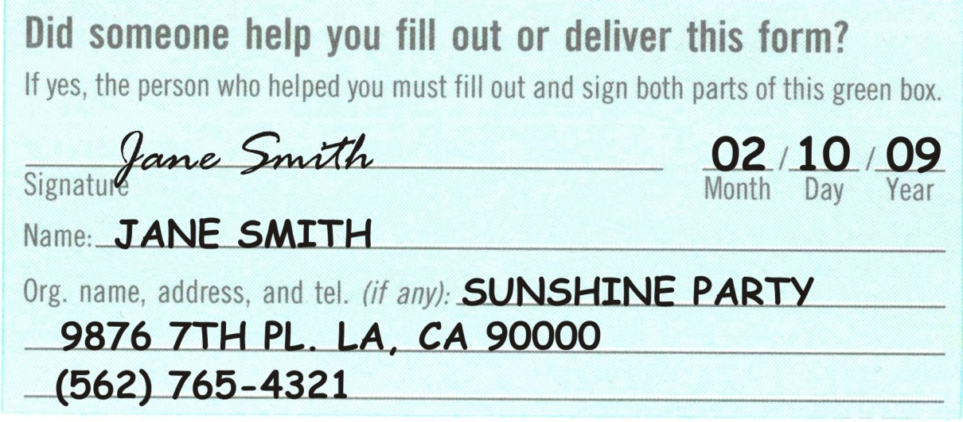
Voter Registration Assistance
Assistance = putting pen to paper, delivering paper form, and/or helping person enter information online
If you provide assistance, you must indicate that on the voter registration form and provide the name and address of the assister.
If you help someone complete and deliver their paper form, you should also fill out and tear off the receipt for the voter to keep.
Notes:
Assister must fill out the blue box above and below the perforation
Answering questions and checking the form for completion do not qualify as “assistance.”
If you are not being paid by an organization to register someone to vote but are still returning the completed form for them, just indicate your personal phone number/address

Slide 17
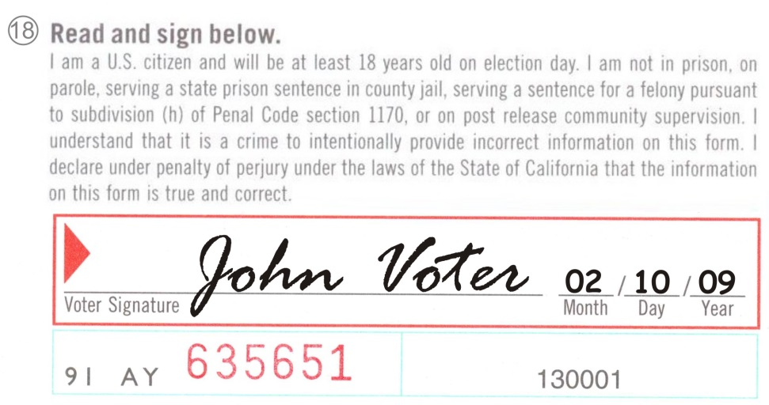
Declaration and Signature
On the paper form, voters commonly miss the signature box often because it is surrounded by legal text. Check!
Check date too!
On the online form, voters can consent to have the DMV share a copy of their signature from their driver’s license, instead of providing a signature.
Notes:
Note: If someone is illiterate or unable to sign due to a disability, they can make a mark instead of a signature. As an assister, you would still need to indicate this mark counts as the voter’s signature
Additional Note: Registrant may sign in their primary language, if that is how they sign other legal documents.

Slide 18
Almost there!
Remember
CHECK EVERYTHING before submitting
Voter should receive a “proof of registration” card within 2 weeks.
Tip: Help the voter sign up for ballot tracking so they know when their mail ballot is coming for the November 2020 election: WheresMyBallot.sos.ca.gov

Slide 19
Helping People Register to Vote
Ideas for how to help your community register:
Hold an online workshop to explain the online registration process
Offer online or phone office hours to help community members register
If public health rules allow, provide in-person assistance & copies of paper forms at community events (call your county elections office for more information on getting paper forms)
Notes:
If you want to distribute 50 or more forms, you will need to fill out a special form that indicates you understand the rules of voter registration drives.

Slide 20
Helping People Register to Vote
Make sure anyone helping to register voters is fully trained.
Must know: voter eligibility rules, specific rules about helping someone register
You do not need to be a citizen or of a particular age to register someone else to vote.

Slide 21
Voter Registration No Nos
You cannot offer an
incentive, prize, cookie, etc.
You cannot influence or tamper with a voter’s party registration.
You cannot register someone who you know is not entitled to register (such as a noncitizen, a person on parole, etc.).
Notes:
Offering an incentive/offering to pay someone to register to vote for any election in which there is a federal contest on the ballot is punishable by a fine up to $10k or imprisonment for up to five years or both
Tampering with a voter’s party registration can lead to imprisonment for 16 months, or 2 or 3 years or in a county mail for up to one year
Registering someone who is not entitled to vote (non citizens, on parole etc) is punishable by imprisonment for up to 3 years or county jail up to 1

Slide 22
Rules about Helping Someone Register to Vote
Respect voter privacy -- If someone wants to register to vote in private, such as by taking their form home or registering later, let them do so.
All eligible voters can register -- You must provide a voter registration form to anyone who requests one and you must turn in any completed registration forms you receive.

Slide 23
Rules about Helping Someone Register to Vote
les for Helping People Register to Vote
If you return a completed registration form for a voter, you must return it to the county elections official or put it in the mail within 3 days (or before Oct. 19, whichever is first).
If you help someone fill out their voter registration form you must indicate that on the form. If you are returning the form for them, you must also fill out the “voter’s receipt” at the bottom of the form and give it to the voter.
Notes:
If you accept a completed registration form from a voter, it must be returned in person, to the county elections official or Secretary of State, or deposited in the mail within three days of receiving it (excluding Saturdays, Sundays and state holidays) or before the close of registration, whichever is earlier. (Elec. Code, § 2138.) Failure to submit completed affidavits of registration within this time frame is a misdemeanor. (Elec. Code, § 18103.)
Anyone helping a person register to vote and returning the completed affidavit to the elections office on behalf of the newly registered voter must fill out the information required on the receipt and give it to the person who is registering to vote. (Elec. Code, § 2158.)

Slide 24
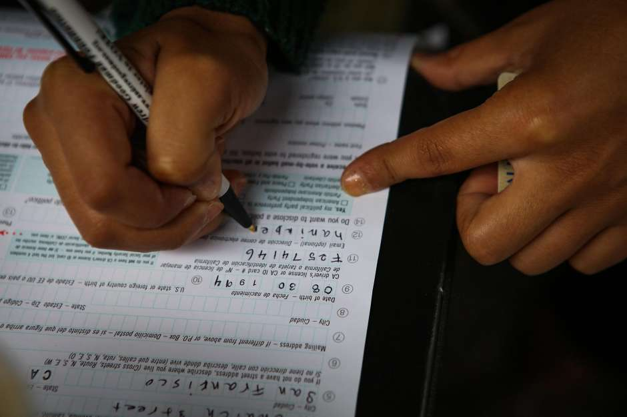
Filling Out The Form
You can help someone fill out the form if they request your help.
If you’re helping with a paper form--
Small mistake? Fix it, then have voter initial.
Big mistake or illegible? Use a new form.
Write legibly in black or blue ink.

Slide 25
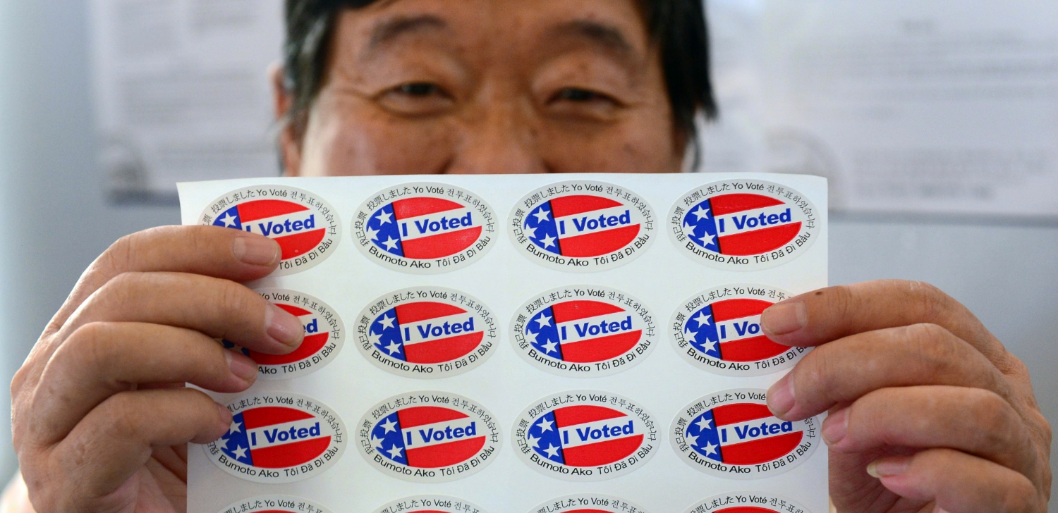
Questions?

