Slide 1
Redistricting:
A Once-In-A-Decade Opportunity!

Slide 2
Goals for Today
Build a high-level understanding of the redistricting process
Identify why redistricting is important for your community members
Learn about opportunities to get involved
Notes:
We understand that folks are probably coming to this with varying levels of knowledge around redistricting
We often hear “we know it’s important” but we want to make it concrete
Hoping at the end you’ll feel grounded in some of the basics and able to identify some of the areas that you might want to learn more about or that you’re interested in focusing on with your communities

Slide 3
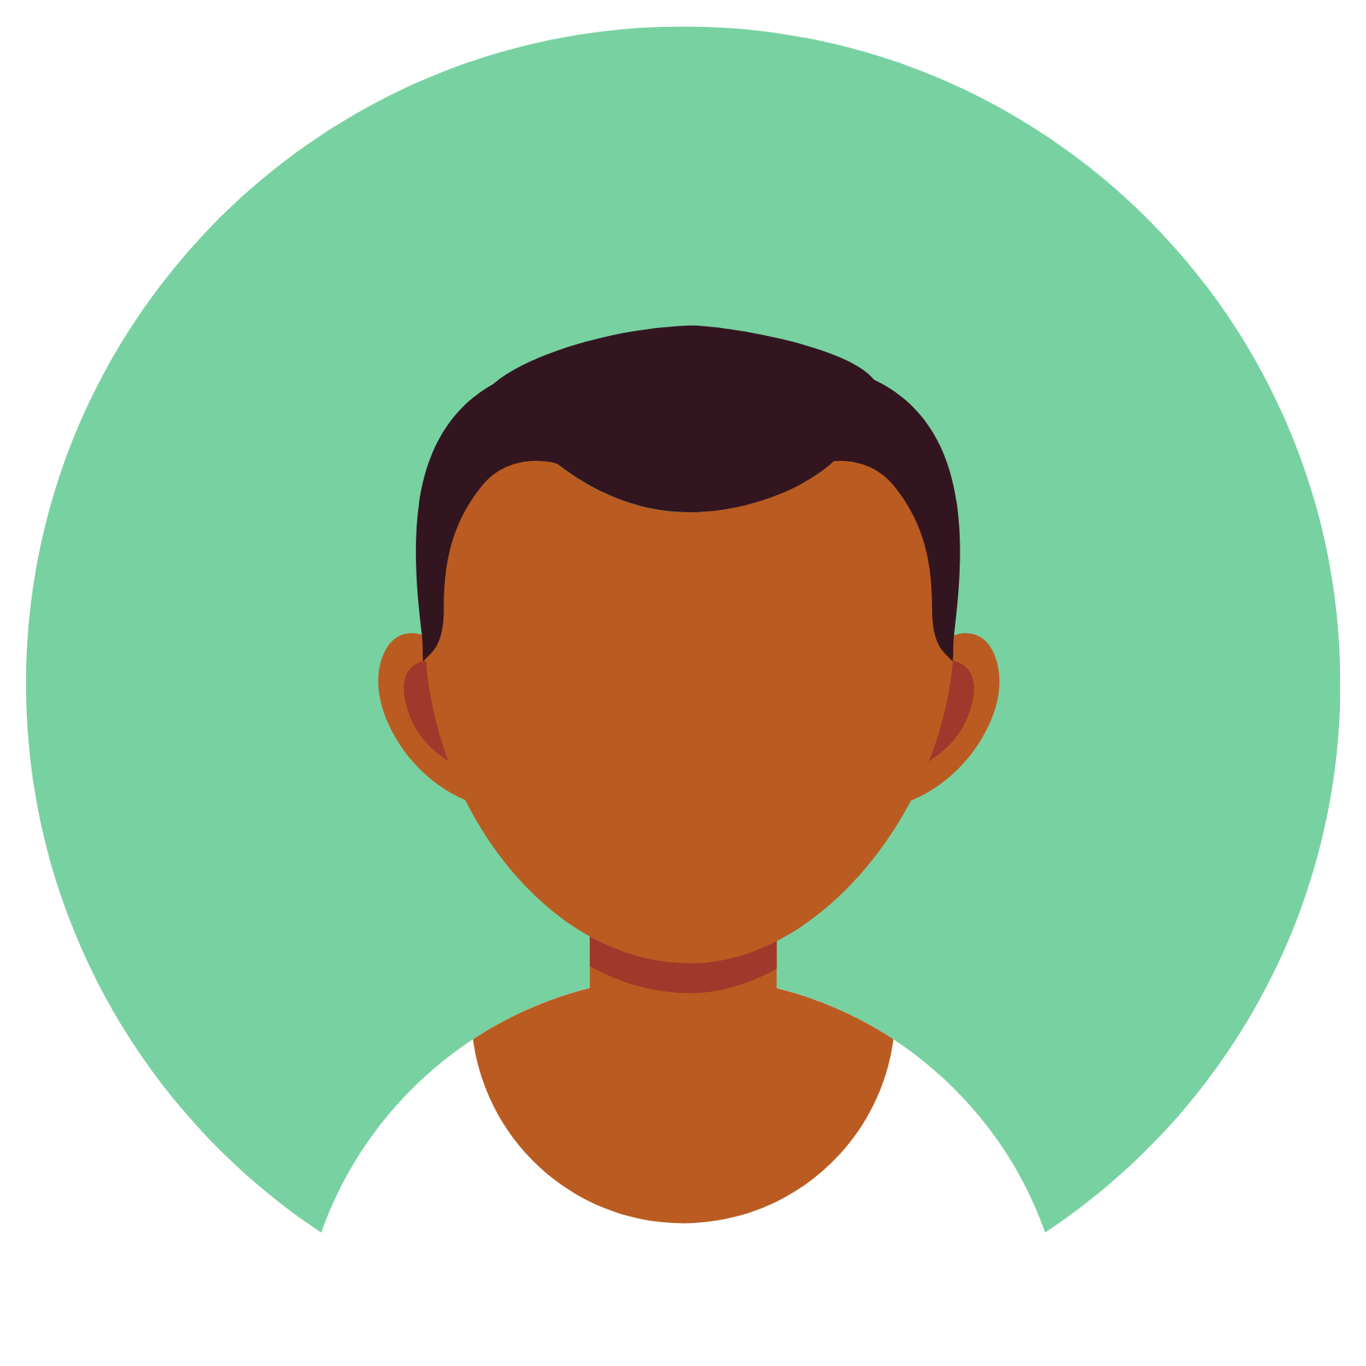
Review: What is Redistricting?
Redistricting is the process of redrawing legislative district lines.
It happens every 10 years, after the census.
It is needed to make sure districts are equal in size and reflect population changes.
6
5
5
4
5
4
5
6
Notes:
This is an overly simplified example: you can see that initially districts are drawn equally, but then people move and populations change, so we have to re-draw the lines to adjust for those changes and re-establish equal representation. There has been a lot of population change in California over the last ten years. The lines are going to change!
Remember - redistricting takes into account all residents, not just people who can vote or people who are citizens. That’s because we all deserve to be represented.

Slide 4
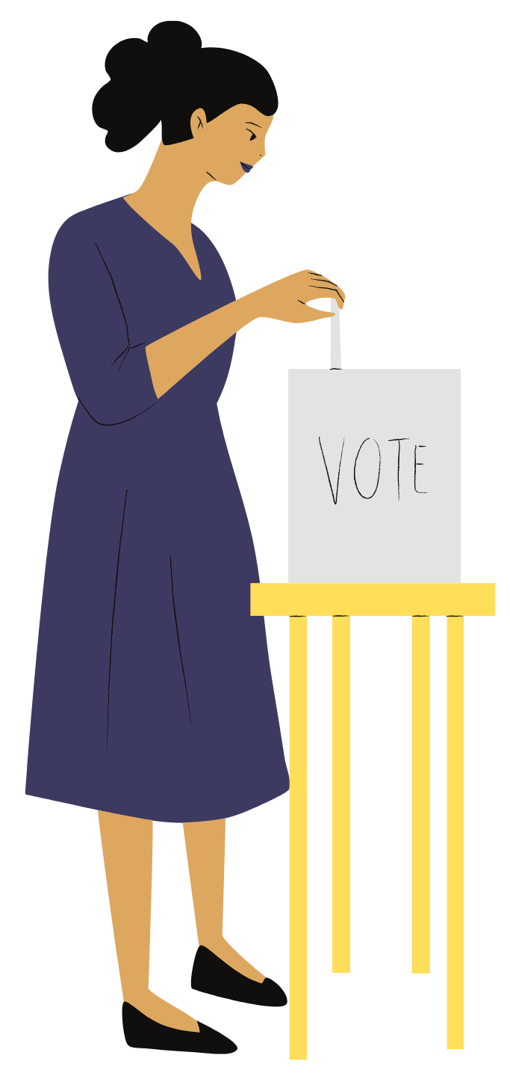
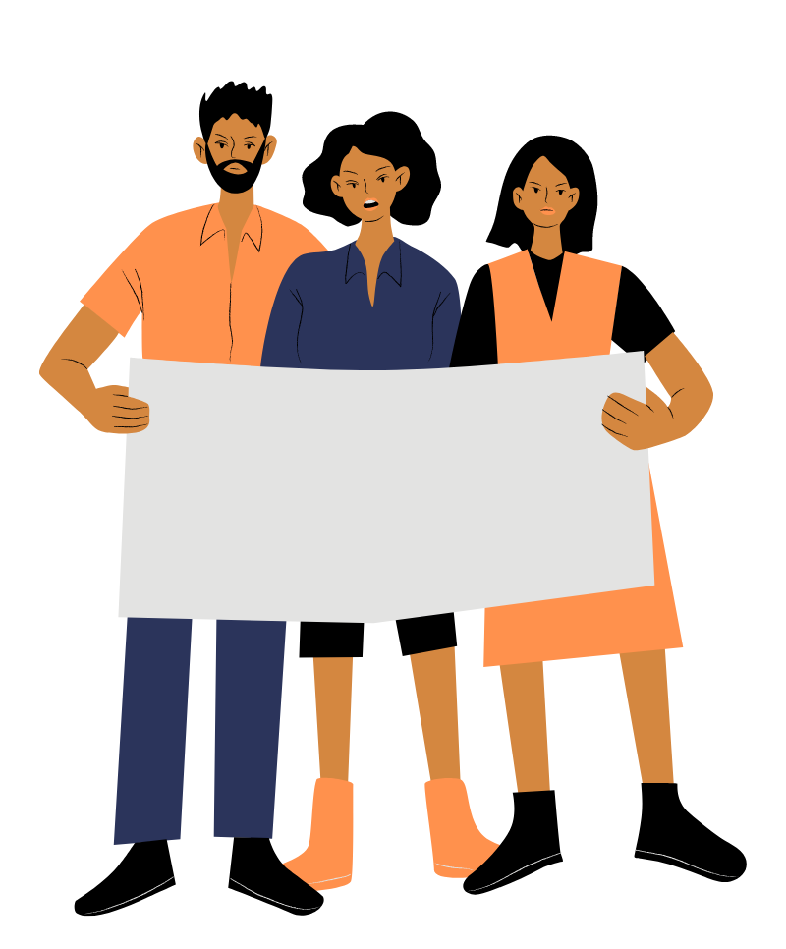
How Do District Maps Affect Our Communities?
Determine political power for the next 10 years
Make it easier or harder for us to elect candidates who represent our values & priorities
Affect our ability to hold politicians accountable, build coalitions, and work with our neighbors for change!
Notes:
In addition to understanding the basics of what redistricting is, it’s important to understand what impact it can have and how it affects our communities. The lines that are drawn during this process will lay the groundwork for our political representation for the next ten years.
Different combinations of communities will produce different possibilities for who can be elected
This is your chance to make sure your community is put in a district with like-minded communities, where you can impact policy
Enables communities to work together to bring issues to your representatives and bring political pressure, to make sure that the people representing you listen to you

Slide 5
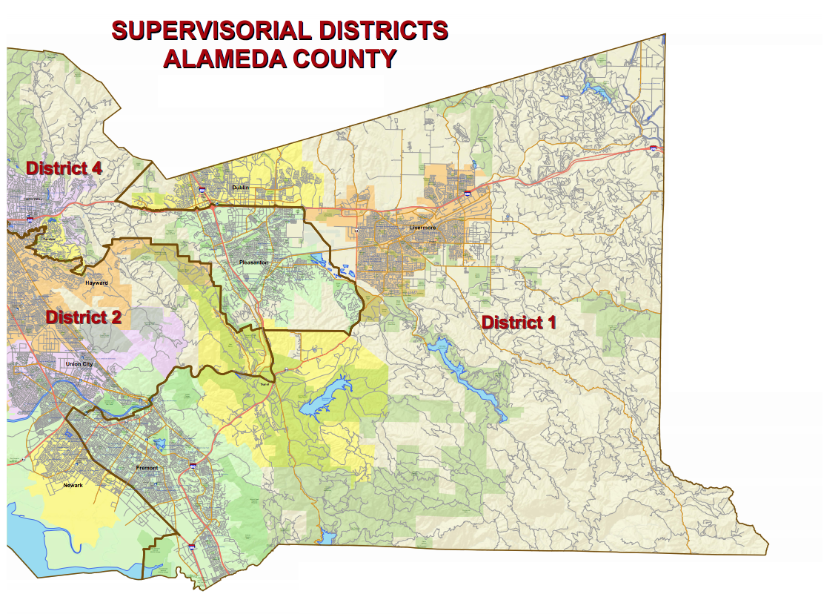
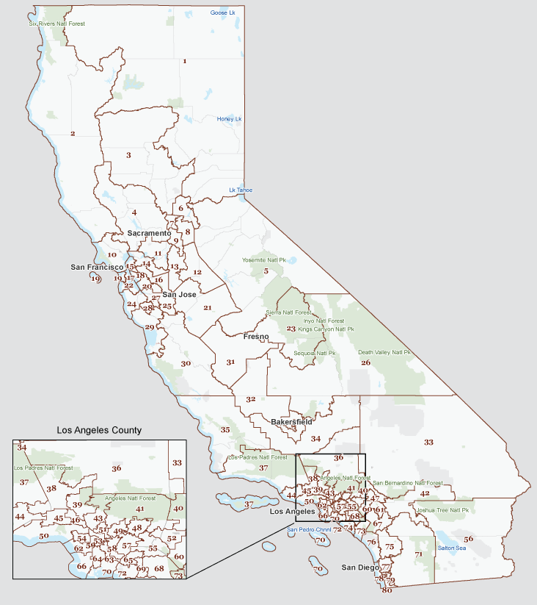
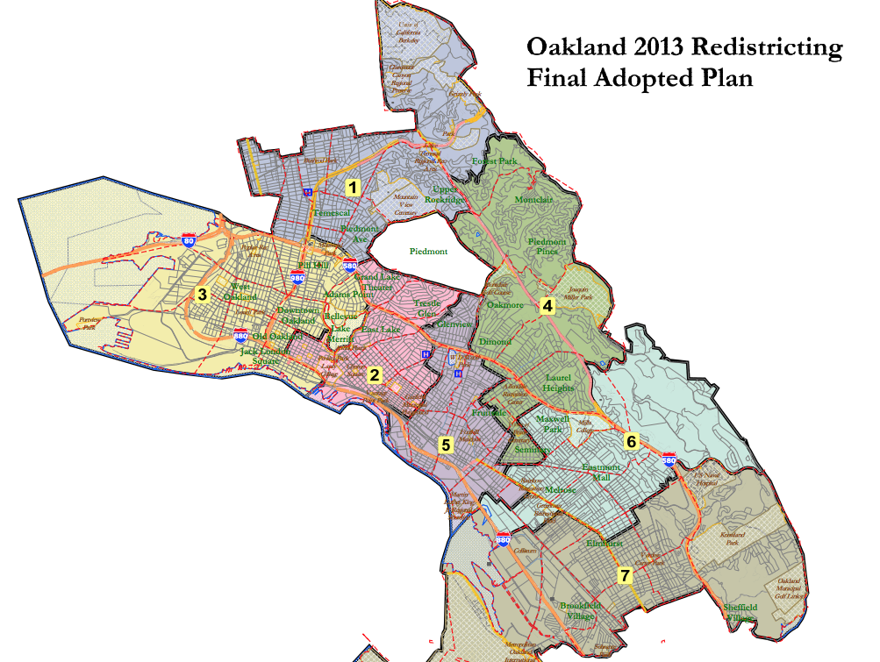
Draw Lines for All Levels of Government
U.S. Congress
California Senate
California Assembly
Board of Equalization
County Board of Supervisors
City Councils
School Boards
Notes:
-State redistricting includes congressional seats, state assembly, state senate, board of equalization
-Local redistricting varies depending on where you are, but it might include county board of supervisors, city council, school board, special districts

Slide 6
Power and Resources for Our Communities
What does my city council decide?
What does my school board decide?
Housing
Libraries
Parks and community centers
Street maintenance
Policing
Land use and zoning (environmental impacts, housing affordability)
and more...
Budgets
School construction
School closures
School assignment
Class sizes
Safety policies
and more...
Notes:
Various elected bodies are responsible for making decisions about the different services and issues that you care about. They are empowered to set priorities, pass laws and decide budgets for programs that directly affect our lives. But ultimately, they answer to the people who gave them their jobs - you! Electing good representatives who you can hold accountable for what your community cares about is one of the ways that you can make sure your community gets what it needs to thrive.
(Optional) Think of an issue that you care about in your community. Do you know who is in charge of making decisions about that issue? We’ll go through some of the important things that are controlled by the various levels of government, and see if you can figure it out.

Slide 7
Power and Resources for Our Communities
What do my state assembly member and state senator decide?
The Legislature creates policies that affect:
Affordable housing
Highways and transportation
K-12 education, college and higher education
CalFresh and other programs for low-income Californians
Health insurance, MediCal
Community health services, including mental health services
Services and programs to address homelessness
Environmental safety and protection
Civil rights and language access rights
and more...
The Legislature decides the budget for:
K-12 education
Health care
College and higher education
Prisons
Highways and transportation
and more...

Slide 8
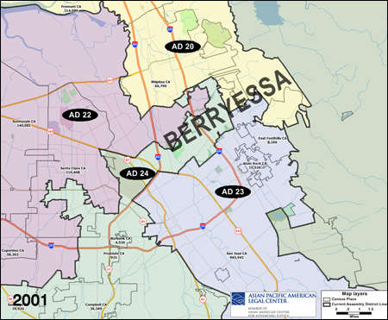
How Do District Maps Affect Our Communities?
In 2001 redistricting, Berryessa (San Jose) was split among 4 Assembly districts.
Over half of Berryessa's population was AAPI and shared common interests and needs.
Notes:
What does it mean for our communities to be respected and empowered by the district maps?
Let’s review an example that demonstrates how lines can be drawn to disempower or empower a community. Berryessa is a neighborhood within the city of San Jose. It’s not huge, somewhere in the ballpark of 40,000 people. Someone who isn’t from the area wouldn’t necessarily notice it on a map.
There are connected business interests and socioeconomic characteristics.
One can imagine that a neighborhood of about 40,000 people would be able to garner much more responsiveness if they were able to target their efforts to one elected official, as opposed to being divided among four offices. Remember, after this map was set, they had TEN YEARS of this.

Slide 9
How Do District Maps Affect Our Communities?
In 2011, the community advocated for their neighborhood to be kept intact. They also asked to be kept with communities in Milpitas, Fremont, and Newark due to shared interests.
They succeeded! Today, they’re represented by Assemblymember Alex Lee.
Berryessa
Notes:
In addition to preserving the Berryessa neighborhood, community members also explained to the line-drawers that they are connected more broadly to areas in other cities. The highway connects these communities that have common industries and a shared economy.
Asking to be kept with Milpitas, Fremont, and Newark is notable especially because this means the district line would cross county lines (Alameda and Santa Clara). This is an example of where it may have been an easy default to draw a line that followed the county lines so it was important for the community to speak up and help the commission understand the community of interest that they would prefer to keep intact.

Slide 10
Who Draws the Lines?
California Citizens Redistricting Commission
Independent
Made up of everyday Californians, not politicians
Holds public input hearings
Draws lines according to criteria set out in the California Constitution
State Offices
Congressional seats
State Assembly
State Senate
Board of Equalization
Notes:
In many states, the lines are drawn by the legislators themselves - not ideal - but in California we have an independent citizens commission!
The Commission was created in 2010, following the Voters First Act (Prop 11) and Voters First Act for Congress (Prop 20).
Commission is selected through an application process and random draw for the first group, and then the final set of commissioners are chosen by the others.
There are 14 commissioners: 5 democrats, 5 republicans, and 4 NPP. They strive to create a commission that is representative of the state by geography, race, gender, education level.
The CCRC has a pretty big job cut out for them. But they do have some guidelines to help them decide how the lines should be drawn. I’m going to turn it over to my colleague Julia to talk a little bit more about HOW they draw the lines.

Slide 11
Local Redistricting Quick Tips
Who draws the lines?
Governing Body
Local Offices
Board of Supervisors
City Councils
School Boards
Special Districts
Independent Commission
Advisory Commission
Hybrid Commission
Notes:
The default rule for local redistricting is still that the legislative body decides the maps. This is changing, as increasingly local governments adopt redistricting commissions, which are recommended by good governance groups.
Three types of commissions:
Advisory (makes recommendations, no decision-making authority)
Hybrid (recommends two or more maps for body to choose from)
Independent (adopts district boundaries for the legislative body)

Slide 12
A Public Process: CCRC
California has a public, non-partisan process for statewide redistricting:
CCRC is independent
CCRC is made up of everyday Californians, not politicians
CCRC holds public input hearings
CCRC draws lines according to criteria set out in the California Constitution

Slide 13
A Public Process: Cities and Counties
Cities and Counties also gather public input:
At least 4 public hearings (at least 1 before drawing drafts and at least 2 after)
Must make accessible to people with disabilities and provide language assistance for certain languages
Input allowed in person, electronically, in writing
You can advocate for more!
Notes:
There are some additional requirements to make sure that the process is accessible to people.
Cities and counties must hold at least 1 hearing outside of regular business hours.
Cities must provide assistance for any language spoken by LEP residents who are more than 3 percent of the city’s total population.
Counties must provide assistance for any Section 203 languages (in San Mateo, Spanish, Chinese, Korean, Tagalog).
If covered, cities and counties need to provide live translation upon request, if made in advance.

Slide 14
Rules for Map-Drawing
When line-drawers create district boundaries, they must consider ranked criteria:
Population Equality
Voting Rights Act
Contiguity
Integrity of Established Geographic Areas - Cities, Counties, Communities of Interest
Compactness
Nesting
Line drawers MAY NOT draw lines to favor or discriminate against a political party.
Notes:
What is important to know is that your community input shapes one of these criteria! You can affect the maps.
These are some of the ‘traditional’ principles used to guide redistricting that are identified by the CA State Constitution as the criteria that should be used to draw maps during California state redistricting. The reform efforts that created the CCRC explicitly focused on these to anchor the citizen-led process. There are plenty of nuances within each of them so we will just briefly touch on them. If you want to dig into any of them more, we will try to answer questions at the end and can share resources with more information.
There is minor variation between state and local rules, but the basic principles are the same.
Remember that the Commission or local line-drawer has to consider all of these, and that the order matters! The criteria are ranked to prioritize some principles over others. For example, they can draw districts that are a little less compact if it is needed to comply with the Voting Rights Act or keeping communities of interest together.

Slide 15
Community Voices Matter
When communities are kept together in a district, they can elect representatives who will pay attention to their issues.
Line-drawers must consider “communities of interest” when they draw the lines. These include:
Cultural, ethnic, and/or religious interests
Economic concerns like working conditions, participation in specific industries, income, renters v. owners
Neighborhood characteristics like public transit, environmental concerns
Social characteristics like age, households with families, health access
Notes:
For both state and local redistricting, the line-drawers have to try to respect “communities of interest.”
“Communities of interest” is a term used to describe different types of communities who have shared traits or concerns that unite them, especially things that may affect their priorities and preferences for different types of policy decisions. For example, an area where the majority of people rely on public transportation may have want to support elected officials who pledge to invest in public transit, whereas an area where most people drive may prefer a representative with different priorities.
The CA Constitution defines a community of interest: A community of interest is a contiguous population which shares common social and economic interests that should be included within a single district for purposes of its effective and fair representation. Examples of such shared interests are those common to an urban area, a rural area, an industrial area, or an agricultural area, and those common to areas in which the people share similar living standards, use the same transportation facilities, have similar work opportunities, or have access to the same media of communication relevant to the election process. Communities of interest shall not include relationships with political parties, incumbents, or political candidates.

Slide 16
Community Voices Matter
I live near ____, and people in my neighborhood really care about ____, _____, and ______
My community lives in __________. What we have in common with each other is ______________.
I think it’s important that my neighborhood is kept in a district with _________, because we both ______________________
Notes:
The best way for line drawers to understand your community and where it lives is to hear from you directly.

Slide 17
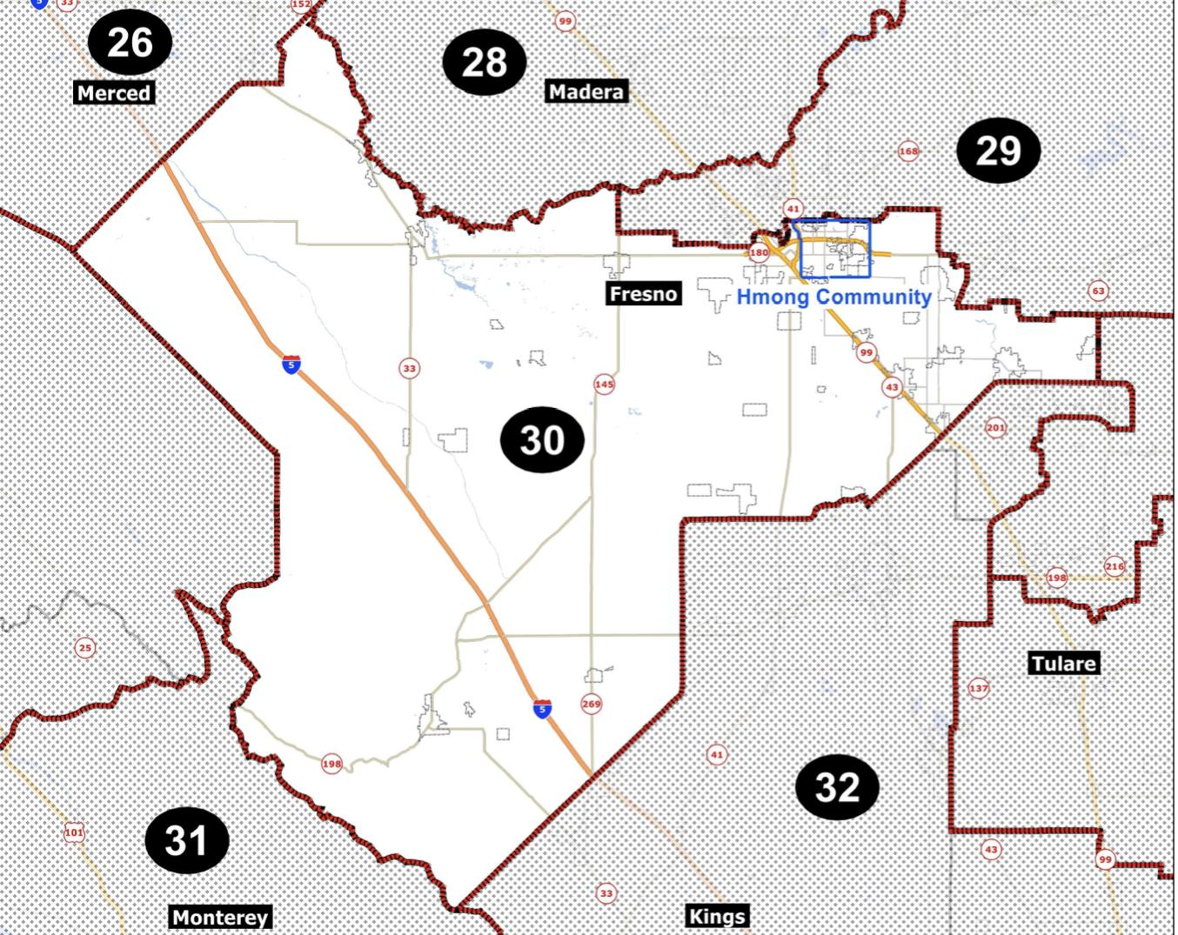
Example - AD-31
AD-31 (then AD-30) is a Latino VRA district.
Community members submitted COI testimony asking the CCRC to keep the Hmong/Southeast Asian refugee whole and grouped with the Latino community due to shared interests.
Adopted district map doesn’t look exactly like this proposed version - but does keep the identified community intact!
Notes:
COI testimony is especially important for AAPI communities in statewide redistricting, because our population may not have the numbers or density to make up the majority of an assembly, senate, or congressional district - but we can still fight to keep our communities whole as the lines are drawn.
This Latino VRA district could easily have been drawn in a way that split the neighborhood OR grouped them with one of the other adjacent districts where their interests were less aligned with the larger population.
Hmong/SEA community members uplifted the fact that their community should be kept whole but also that they share many policy interests with the Latino community due to many similar socioeconomic characteristics.

Slide 18
How to Get Involved
Shape the process in your community. Can it be more open, inclusive, and fair?
Tell the line-drawers about your Communities of Interest at pre-map hearings.
Use online tools to draw your community and/or draft a map proposal.
Review draft maps and give input at public hearings. Does the proposal keep your community together?
Notes:
[Direct participants to a Mapping Communities of Interest workshop, or to online resources about how to submit COI. The online COI submission tool for the CCRC is at https://drawmycacommunity.org/. People can also submit by written comment or go to a hearing to give oral comment.]

Slide 19
How to Get Involved: Timeline
Statewide Redistricting
SUBJECT TO CHANGE
Public hearings to hear about peoples’ communities | Summer - Fall 2021
Public input meetings about what district maps should look like | October - November 2021
Draft maps posted, additional public meetings to provide feedback | November - December 2021 *might be extended to January 2022
Maps finalized | Late December 2021 *might be extended to January 2022
Notes:
The redistricting deadlines have been changing because of census delays caused by COVID-19.
You can get up-to-date information about the CCRC’s timeline and upcoming meetings at https://www.wedrawthelinesca.org/meetings

Slide 20
How to Get Involved: Timeline
Local Redistricting
SUBJECT TO CHANGE
Public hearings to get community testimony | Summer - Fall 2021
Draft maps posted, additional public meetings to provide feedback | November - December 2021 *might be extended to January 2022
Maps finalized | Counties and some cities have a map deadline of 12/15/21, but that might be extended to January 2022 Some cities have a map deadline of 4/17/22.
Notes:
The redistricting deadlines have been changing because of census delays caused by COVID-19.
Check the website of your city, county, and school board to find out more about their process and timeline.

Slide 21
Questions?
Find more resources at bit.ly/ALC-CA-Redistricting
Contact: redistricting@advancingjustice-alc.org

